Slide 1
Azure SQL Database
Michal Morciniec
Partner Technical Consultant
micham@microsoft.com

Slide 2


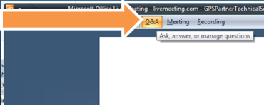
Getting Live Meeting Assistance
In case you have voice quality problems during the session
Click the drop-down arrow next to “Feedback” on the Menu Bar (top right corner)
Change your feedback color
Have questions?

Slide 3
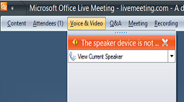
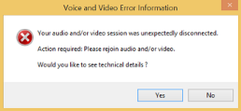
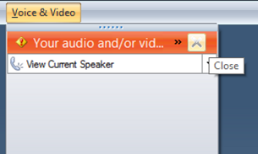
Tips when losing audio
Click the Voice & Video on the Menu Bar
You might get error message like this:
Close this error
Then click Join Audio
Notes:
This could happen due to lost connectivity with audio device on your machine.. You need to rejoin audio.

Slide 4
Still having audio issues?
Contact MS Support from the attendees list (available in the first 10 minutes)
Try to exit and re-login again to the meeting
When MS Support agent is not available send an email to:
weregsup@microsoft.com
Notes:
This could happen due to lost connectivity with audio device on your machine.. You need to rejoin audio.

Slide 5
Agenda
SQL in Azure, what are the options?
Azure SQL Database Architecture
Scaling Azure SQL Database Service
SQL Database Business Continuity
Security and Audit
Migrating from on premise SQL to Azure SQL Database
Notes:
5

Slide 6
SQL in Azure
What are the options? IaaS vs PaaS
Notes:
20

Slide 7





SQL Options
Shared
Lower Cost
On Premises
Azure SQL DB
(PaaS)
SQL on Azure VM (IaaS)
SQL on Private Cloud
SQL on bare metal
Dedicated
Higher Cost
Off Premises
High Control
Low Control
Notes:
Today you have a range of possibilities where and how you can host SQL Server databases wither on and off premises.
<click>
The first obvious option is to run SQL Server on a physical server. With this option you acquire the hardware and server resources and dedicate them to SQL Server.
<click>
The next move is where you host SQL Server on a virtual machine on your private cloud. You still have to secure hardware and resources, but the Server will run as a virtual instance along other virtual servers in the private cloud.
<click>
You can also host the virtual machine on Azure.
SQL Server in Azure Virtual Machine (VM) falls into the industry category Infrastructure as a Service (IaaS) and allows you to run SQL Server inside a virtual machine in the cloud. It is built on standardized hardware that is owned, hosted, and maintained by Microsoft. When using SQL Server in a VM, you can either bring your own SQL Server license to Azure or use one of the preconfigured SQL Server images in the Azure portal.
<click>
The next evolution in the cloud would be to have SQL Database as a service.
(Azure SQL Database) is a relational database-as-a-service, which falls into the industry category Platform as a Service (PaaS). Azure SQL Database is built on standardized hardware and software that is owned, hosted, and maintained by Microsoft. With SQL Database, you can develop directly on the service using built-in features and functionality. When using SQL Database, you pay-as-you-go with options to scale up or out for greater power.
Azure SQL Database is optimized to reduce overall costs to the minimum for provisioning and managing many databases. It minimizes ongoing administration costs because you do not have to manage any virtual machines, operating system or database software including upgrades, high availability, and backups. In general, SQL Database can dramatically increase the number of databases managed by a single IT or development resource.
We dedicate this session to cover SQL Database. However to gain better understanding, in the coming few slides we are going to explain differences between SQL Server on Azure VM and SQL Database.
References:
http://azure.microsoft.com/en-gb/documentation/articles/data-management-azure-sql-database-and-sql-server-iaas/
http://azure.microsoft.com/blog/2013/02/14/choosing-between-sql-server-in-windows-azure-vm-windows-azure-sql-database/

Slide 8
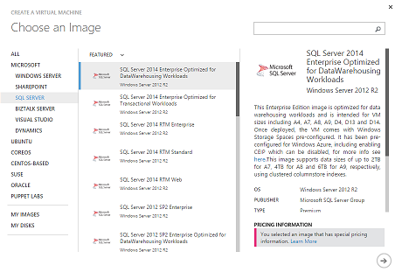
SQL Server on Azure VM (IaaS)
Provision Platform Images
SQL 2008 R2, SQL 2012 on Win 2008 R2 or Win 2012; SQL 2014 on Win 2012 R2
Pay per minute Licensing Model
Provision your own Image
Upload your sysprep VHD to Azure Storage
License Mobility with Software Assurance
Notes:
With SQL Server in Azure Virtual Machines, you get the full benefits of infrastructure-as-a-service offering in Microsoft data centers. Therefore, you have the full-control of the virtual machines that run your SQL Server as well as your applications and databases in Azure. You can move your enterprise breadth applications in your own virtualization platform on-premises to Azure by leveraging SQL Server in Azure Virtual Machine instead of purchasing new hardware to run your increasing needs. When you need more hardware just for a specific time period or to do validation or testing of your new application, Azure Virtual Machines provide flexibility to match your needs. You can build hybrid applications by hosting SQL Server databases in Azure Virtual Machines. Therefore, you can make your databases available to both on-premises and cloud applications.
You can provision SQL Server VM on Azure in two ways.
The Azure virtual machine gallery includes several images that contain Microsoft SQL Server. You can select one of the virtual machine images from the gallery and with a few clicks you can provision the virtual machine to your Azure environment. This way you pay for the SQL license per minute in addition to the Virtual Machine compute and OS.
Another option is to upload your own VHD to an Azure storage account and then create the SQL Server using that image. With this option you need License Mobility with Software Assurance to be able to relocate your sql server license.
References:
http://msdn.microsoft.com/en-us/library/azure/dn133151.aspx
License mobility: http://azure.microsoft.com/en-gb/pricing/license-mobility/

Slide 9
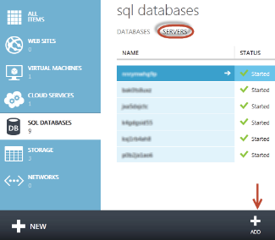
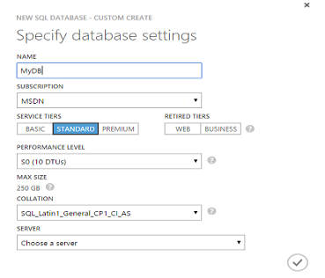
Azure SQL Database (PaaS)
SQL Server technology as a service
Exposes TDS Endpoints
Almost instant provisioning
Automatic support for HA
Scale up/down easily
Notes:
Microsoft Azure SQL Database provides a Relational Database Management System based on SQL Server technology. Microsoft Azure SQL Database exposes a tabular data stream (TDS) interface, and Transact-SQL (T-SQL), so many of the tools and applications that work with SQL Server also work with Microsoft Azure SQL Database. Applications written using existing technologies such as ADO.NET and ODBC to communicate with SQL Server can be updated to access Microsoft Azure SQL Database with minimal code changes. Microsoft Azure SQL Database also provides standard SQL Server features such as stored procedures, views, multiple indexes, joins, and aggregations.
There are many ways to incorporate Microsoft Azure SQL Database in your database application. In a traditional on-premises application, the application code and database are located in the same physical data center. Azure SQL Database offers many alternatives to that architecture.
For example, your application code remains on-premises, but the database resides in Azure SQL Database. Your application code uses client libraries to access your database(s) in Microsoft Azure SQL Database
Another scenario is when your application code is hosted in Azure and your database resides in Azure SQL Database. Your application can use the same client libraries to access your database(s) in Azure SQL Database as are available in previous scenario.
Azure SQL Database has a built-in high availability subsystem that protects your database from failures of individual servers and devices in a datacenter. We are going to talk about this in more details in the coming section of this presentation and also when we talk about “Business Continuity”
References:
http://azure.microsoft.com/en-gb/documentation/articles/data-management-azure-sql-database-and-sql-server-iaas/
http://msdn.microsoft.com/en-us/library/azure/jj156158.aspx
http://msdn.microsoft.com/en-us/library/azure/ee336239.aspx

Slide 10
Comparing IaaS and PaaS
Feature | Azure SQL Database | Microsoft SQL Server on Azure VM
Administration | Minimal | Full Control
SQL License | -- | Pay Per Minute*/BYO License
HA, DR and Backup | Built-in Support | Managed by user
Scalability | Good (Mostly Out) | Fair (Mostly Up)
Database Size | 500 GB | 64 TB (G-series)
SQL Server features | DB engine only | Full Support **
TCO | Eliminates HW and admin costs | Eliminates HW costs
Time to Market | Perfect when developing new applications on the cloud | Perfect when migrating existing applications to the cloud
SLA | 99.99% (Basic, Standard, Premium) | 99.95% ***
* To provide your own license you need License Mobility with Software Assurance
** Azure virtual machines do not support Failover Cluster Instances (FCI)
*** You need to have at least two machines in the same availability set
Notes:
So, now we com to compare both Azure SQL Database and SQL Server on Azure VM.
It is important to understand that each offering is optimized for different purposes.
Azure SQL Database is optimized to reduce overall costs to the minimum for provisioning and managing many databases. It minimizes ongoing administration costs because you do not have to manage any virtual machines, operating system or database software including upgrades, high availability, and backups. In general, SQL Database can dramatically increase the number of databases managed by a single IT or development resource.
SQL Server running in Azure VM is optimized for extending existing on-premises SQL Server applications to Azure in a hybrid scenario or deploying an existing application to Azure in a migration scenario or dev/test scenario. An example of the hybrid scenario is keeping secondary database replicas in Azure via Azure Virtual Network. With SQL Server in Azure VMs, you have the full administrative rights over a dedicated SQL Server instance and a cloud-based VM. It is a perfect choice when an organization already has IT resources available to maintain the virtual machines. With SQL Server in VM, you can build a highly customized system to address your application’s specific performance and availability requirements.
References:
http://azure.microsoft.com/en-gb/documentation/articles/data-management-azure-sql-database-and-sql-server-iaas/
http://azure.microsoft.com/blog/2013/02/14/choosing-between-sql-server-in-windows-azure-vm-windows-azure-sql-database/

Slide 11
Create SQL Database
Notes:
Demo 0:
Alternative demo from Powershell Demo-0CreateDbWithPowershell
-Create database and server we-demo from new portal. Select creating sample database AdventureWorksLT.
-Define at server the forewall rules
-Start sql management studio, run SELECT @@version;
Note if you expand tables you may not see immediately tables for the AdventureWorks. Typically 3-5 min for entire creation process is required.
- You can show old portal in the mean time – show V2 database and the Sivlerlight management tool (log as micham)

Slide 12
Azure SQL Database
Architecture
Notes:
45
The rest of this presentation will be on SQL Database

Slide 13

TDS Endpoints
Machine 1
Resource Governor
SQL Server Instance
Connection Routing
User DB1
User DB2
User DB3
Azure SQL Database Gateway Service
Machine 2
Client
Application
Billing & Metering
SQL Server Instance
SQL Database Firewall
User DB4
User DB5
User DB6
Logical Server
(TDS Protocol)
Machine 3
Provisioning
SQL Server Instance
User DB7
User DB8
User DB9
Notes:
Let us consider how applications connect to Azure SQL DB. To understand how this works, we need to keep in mind that Azure SQL DB provides a large-scale multi-tenant database service on shared resources.
<click>
Azure SQL DB provides the same tabular data stream (TDS) interface as SQL Server.
TDS is an application-level protocol for communication between client applications and SQL Server. It facilitates and standardizes interaction with database servers to provide authentication, sending SQL statements, invocation of functions, returning data and transaction management.
Because Azure SQL DB exposes TDS. This makes it possible to use familiar tools and libraries to build client applications for data that is in the cloud. The Azure SQL Server which you saw listed in the “Servers” tab in the previous demo, is a Logical Server that hides many of implementation details from the client applications. Let us dig deeper into some key characteristics of this implementation.
<click>
First, because Azure SQL DB provides a relational database service that is available over the internet. Your requests have to pass through Azure SQL DB firewall which prevents all access to your Azure SQL Database server until you specify which computers have permission. The firewall grants access based on the originating IP address of each request. As you saw in the demo, there are couple of things involved here:
If your application connects to SQL DB over the internet, then your client application IP must be in an allowed range to get through.
If your application is hosted on Azure, then all what you need to do is to Allow Windows Azure Services to Access the Server either when creating the DB or from the configuration tab.
<click>
The Azure SQL DB Gateway functions as a gateway between your application and the underlying platform, where your data resides. It performs the functions of data center isolation, provisioning, billing and metering, and connection routing.
<click>
To enable load balancing and high availability, databases associated with your SQL Database server may reside on separate physical computers in a Microsoft data center. Each physical computer can service many databases. When there is enough capacity, all the sessions can take full advantage of the available resources in SQL Database. However, if resources run low at peak times, SQL Database terminates the sessions using excessive resources to provide a stable system and prevents sessions from monopolizing all the resources till resources become available.
<click>
The underlying platform consists of many instances of SQL Server, each of which is managed by the SQL Database fabric. The SQL Database fabric is a distributed computing system composed of tightly integrated networks, servers, and storage. It enables automatic failover, load balancing, and automatic replication between physical servers.
<click>
A unique feature of SQL Database is its ability to monitor and rebalance active and online user databases in the Microsoft data centers automatically. To achieve this, SQL Database continuously gathers and analyzes database usage statistics and will terminate connections when necessary.
Throttling is a mechanism used by SQL Database to prevent machines from becoming overloaded and unresponsive. Throttling works by monitoring resource consumption metrics for each machine in a cluster. When a metric exceeds a threshold, work is slowed down or aborted until the metric falls back below the threshold.
References:
http://social.technet.microsoft.com/wiki/contents/articles/1541.windows-azure-sql-database-connection-management.aspx
http://social.technet.microsoft.com/wiki/contents/articles/1695.inside-microsoft-azure-sql-database.aspx
Firewall: http://msdn.microsoft.com/en-us/library/azure/ee621782.aspx

Slide 14
SQL Database Resource Governance
Machine
Resource Governance
Emulates running in own machine
Queries could be queued if resource limits are reached
Limits Enforcement
DB Size
Transaction Duration, Lock Count, Log Length
Memory Usage
Throttling
Compute
Writes
Reads
40501: The service is currently busy. Retry the request after 10 seconds. Incident ID: <ID>. Code: <code>.
Notes:
Azure SQL DB is multi-tenant offering, which means that databases from other tenants could be running on the same machine and sharing physical resources with your DB. This is why SQL DB is cheaper because it enables you to save money when you don’t need all of the physical resources.
Because of that, SQL Database implements resource governance to achieve couple of things. First, it emulates running each SQL DB instance in its own environment, completely isolated from other databases to ensure that you have predictable performance level for your service tier. Resource governance emulates this behavior during the execution of queries. If the aggregated resource utilization reaches the maximum available CPU, Memory, Log Writes and Query IOPS resources assigned to the database, resource governance will queue queries in execution and assign resource to the queued queries as they free up.
Secondly, it enforces threshold limits on your SQL Database, so when your database breaks these limits work will be slowed down, queued or suspended. For example, of your database crosses the size limit, all work will be suspended until you either upgrade the database or decrease the size.
The number of connections to a SQL database as well as the number of requests that can be processed in parallel are restricted. SQL Database allows the number of connections to the database to be greater than the number of concurrent requests to support connection pooling.
Connections can be terminated when:
Hardware failures or server balancing occurs
You consume too many resources, too quickly
A query or transaction takes too much time to execute
Engine throttling follows these steps to reduce load and protect system health:
1. Determines the load reduction required to return the system to a healthy state. 2. Marks subscriber databases that are consuming excessive resources as throttling candidates. 3. Calculates how many candidate databases must be throttled to return the system to a healthy. 4. Throttles the calculated number of candidate databases until system load is returned to the desired level.
When throlltling occurs to your database, an error 40501 is retruend to your application.
You can figure out the degree and mode of the throttling applied by using the Incident ID and Code values in the error message. Any databases that are throttled remain throttled for at least the duration of one throttling cycle (which is 10 seconds), but throttling may often persist for multiple throttling cycles to return the system to a healthy state.
With each throttling error you get, there is the incident ID, which is a unique GUID generated specifically for your request. If you cannot determine why the throttling occurred or if it persists, and you do not know how to resolve it, contact Microsoft Support and state the incident ID .
Also, The reason code (<code>) in the error message is a decimal number that contains information about the throttling mode and the exceeded resource type. You can use this code and implement logic in your application to determine how bad is this event and what resources are causing it.
Because this behavior is not uncommon in cloud databases, you should retry when a connection termination is a transient fault and temporary due to throttling. Recent versions of ADO.NET provides retry capability out of the box for Azure SQL DB. (AzureSqlDatabaseExecutionStrategy)
Background information:
Web & Business Edition = Unpredictable performance
Basic , Standard & Premimum = predeicatable performance, the more you scale up, the more you have more precision
References:
http://msdn.microsoft.com/en-us/library/azure/dn338083.aspx
http://msdn.microsoft.com/en-us/library/azure/dn338079.aspx
http://msdn.microsoft.com/en-us/library/azure/dn338081.aspx
http://social.technet.microsoft.com/wiki/contents/articles/3507.windows-azure-sql-database-performance-and-elasticity-guide.aspx

Slide 15


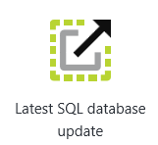
Logical Server versions
V2 Logical Server
-many database incompatibilities
-service tiers
Web, Business (legacy)
Basic, Standard, Premium
Upgrade to V12 is one-way
only!
V12 Logical Server
highly compatible with SQL 2014 db engine
service tiers and new features
Basic, Standard, Premium only
Elastic Database Pool
SELECT @@version;
Notes:
There are now Azure Database logical server versions:
-V2 – original version that has many db engine incompatibilities, for example does not support CRL Assemblies, Full text search,
XML Indices, required clustered index on tables, etc.
This versions supported originally Web and Business editions in the pay per database size model.- The Web and Business service tiers will be retired in September 2015.
Although V2 server supports the pay per performance service tiers Basic, Premium and Standard it does not support all latest features
That are being added to V12 server, such as elastic database pool or the new features such as database auditing and security features, such as data-masking, row level
Encryption,. Etc.

Slide 16
SQL Database V12 (GA since January)
Added Support:
Table Partitioning
More DBCC commands
CLR Assemblies
Data-Masking, RLS, TDE (preview)
SELECT…INTO
XML Indexes
Tables with no Clustered Index
Columnstore Queries (Premium)
Full Text Search…
Set of SQL Server 2014 not supported in v12 SQL Database:
https://msdn.microsoft.com/library/azure/ee336281.aspx
Windows auth, FILESTREAM, Database Mail, Service Broker,
SQL Server Profiler, Distributed transactions…
,
Notes:
There has been many improvements in V12 version which is generally available
--Table partitioning by rows with related enhancements to TRUNCATE TABLE.
- Support for in-memory columnstore indexes.
-The availability of dynamic management views (DMVs) and Extended Events(XEvents) to help monitor and tune performance.
-Security Improvements Data-Masking, Row Level Security, Transparent Data encryption
There is still a set of features not supported in
References:
https://azure.microsoft.com/en-gb/documentation/articles/sql-database-preview-whats-new/
http://blogs.msdn.com/b/ssdt/archive/2014/12/18/sql-server-database-tooling-preview-release-for-the-latest-azure-sql-database-update-v12-preview.aspx

Slide 17
Management Tooling
Azure Management Portal
SQL Database Management Portal
SQL Server Management Studio
REST API & PowerShell
3rd Party Tools
Server Configuration
Database Creation
Firewall Configuration
High Level Monitoring
HTML based
Rich browser based IDE
Database design
View stats and query plans
Silverlight based
NOT AVAILABLE WITH V12 SERVER
Object Explorer
Query Windows
Execution Plans
Control deployment
Automate management
Useful for lifecycle management
Continuous build/integration
TDS Compatability
Visual Studio SQL Object Explorer
RedGate
ERWin
DB Artisan
Etc…
Notes:
You can manage Azure SQL database using numerous tools. First, the Azure Management Portal gives you opportunity to provision and configure servers and databases as well as monitoring their performance.
Along with Azure Management Portal, you can also use the online SQL Database Management portal. With this tools you can design database tables and artifacts in addition to executing queries.
SQL Server Management Studio is a de facto tool to manage SQL Server and as you have seen in the demo, you can use it too to do the same with SQL Database. However, as there are many features not available to Azure SQL Database they are disabled in the Management Studio.
You can also use REST APIs and Powershell cmdlets to control and automate provisioning and deployment. This is very useful in your development lifecycle when for example you want to automatically create databases to perform some unit tests and then delete the db.
Finally, because it exposes itself as a TDS endpoint, any tool that is capable of communicating through this protocol can be used to manage SQL database.

Slide 18
Scaling Azure SQL Database
Service Tiers
Notes:
30

Slide 19
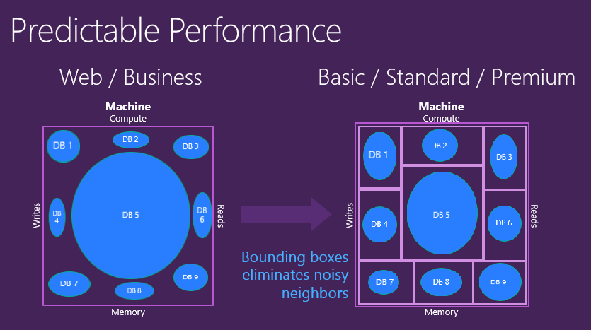
Predictable Performance Model
https://azure.microsoft.com/en-us/documentation/articles/sql-database-upgrade-new-service-tiers/
Notes:
https://azure.microsoft.com/en-us/documentation/articles/sql-database-upgrade-new-service-tiers/
Web and Business databases have no specific amount of resource capacity reserved for any individual database. Additionally, there is no mechanism in place for customers to scale performance up or down for a Web or Business database. This results in Web and Business database performance ranging anywhere from agonizingly slow up to Premium levels. This varying range of performance is unfairly dependent on the overall level of resource consumption at any point in time by other databases within the multi-tenant environment that share resources

Slide 20
Scaling Azure SQL Database
Scale Up
Add more resources to the database node
Scale Out
Partition data to host on multiple nodes.
Premium
Standard
Basic
Shard1
Shard2
Shard 3
Notes:
As with any cloud feature, scaling Azure SQL database might involve scaling up or out database resources.
<click>
Scale up means adding more physical resources, such as CPU, memory and space to your database. In Azure SQL Database, you can perform scaling up or down by moving from one Service Tier to another. SQL Database has 3 tiers: Basic, Standard and Premium. We will talk more about these tiers in the coming slide.
Because there are limits to performance and capacity of standardized hardware and service tiers, scale out becomes a necessity.
<click>
Scaling out the database stands for sharding, which means partitioning data across multiple databases instead of saving and retrieving all from a single database.
<click>
Each database in this model is referred to as Shard. To implement sharding or scale out, you can design and develop your own mechanisms for defining shards, routing connections, and managing data distribution among them.
Otherwise there is a new preview feature: “Elastic Scale” which is a set of .Net libraries which allows applications to define how data is mapped to shards and routes OLTP requests to appropriate databases.
<<cut this>> Finally, this is an older, now depreciated feature, Azure SQL Database Federation. You should not rely on this feature anymore as it is retired soon. You can rely on implementing custom logic or use Elastic Scale in your .net applications.
<<TODO:>>
Give examples of when vertical scaling is used and when horizontal scaling is used.
References:
http://msdn.microsoft.com/en-us/library/azure/dn495641.aspx

Slide 21
Scaling Up
Service Tiers and Service Objectives
Notes:
30

Slide 22
What are DTUs?
“Horse-power” for Databases
DTUs provide a way to describe the relative capacity of a performance level based on a blended measure of CPU, memory, and read and write rates offered by each performance level. Doubling the DTU rating of a database equates to doubling the database power.
Notes:
Before delving more into what service tiers are available in SQL DB, it is important to highlight a key concept in measuring SQL DB service tier performance. When you select a service tier for your application, you get to also select a DTU or performance level.
Database Throughput Unit (or for short DTU): provide a way to describe the relative capacity of a performance level of Basic, Standard, and Premium databases. DTUs are based on a blended measure of CPU, memory, reads, and writes. As DTUs increase, the power offered by the performance level increases. For example, a performance level with 5 DTUs has five times more power than a performance level with 1 DTU.
References:
http://msdn.microsoft.com/en-us/library/azure/dn741336.aspx
http://msdn.microsoft.com/en-us/library/azure/ee336245.aspx

Slide 23
Database performance and throughput -DTUs
Compute
DTU database throughput unit
DTUs
Writes
Reads
0
0
2
3
4
1
0
Memory
Notes:
Database with 10 DTUs has certain CPU power, Memory and Data writes and Writes.
If you need to burst in any of the dimension beyond the limit you will need more DTUs

Slide 24
Predictable Performance Levels
Basic, Standard, and Premium provide increasing performance levels
Scale via portal, PS, REST APIs, or T-SQL to reflect actual or anticipated demand
Database remains online while scaling
Hourly billing provides cost efficiency
P3
P2
P1
S3
S2
S0
S1
B
DTUs
5
10
20
50
100
125
250
1000
Notes:
Read the points.
Note that S3 level is only available on V12 servers

Slide 25
SQL Database Service Tiers
 | Basic | Standard | Premium
DB Size | 2 GB | 250 GB | 500 GB
Max Sessions | 300 | 2,400 | 19,200
Restore | 7 days | 14 days | 35 days
DR | Restore to another region | Standard Geo-Replication | Active Geo-Replication
Predictability | Good | Better | Best
Performance Levels (DTU) | Basic → 5 | S0 → 10 S1 → 20 S2 → 50 S3 → 100 | P1 → 125 P2 → 250 P3 → 1000
Application | Test & Development | Most Applications | Mission Critical
Notes:
So, now this is a review of the different service tiers we have in SQL DB.
As you can see, the DB Size grows from 2GB for Basic, 250 GB in Standard to 500 GB maximum on Premium.
You can have a maximum of 300 concurrent sessions on Basic, 2400 on Standard and 19200 on Premium.
Database automatic backups are retained or 7 days for basic, 14 days for Standard and 35 days for premium. Additional Disaster recovery options are available to Standard and Premium tiers.
As a general guidance for selecting the suitable tier for your application:
Basic is Best suited for a small size database, supporting typically one single active operation at a given time. Examples include databases used for development or testing, or small scale infrequently used applications. Standard is The go-to option for most cloud applications, supporting multiple concurrent queries. Examples include workgroup or web applications. While Premium is Designed for high transactional volume, supporting a large number of concurrent users and requiring the highest level of business continuity capabilities. Examples are databases supporting mission critical applications.
Bear in mind that you can start with smaller tier and DTU and monitor your application’s performance. Then you will be able scale up or down based on the load you expect.
<<cut this>> There are couple of other deprecated tiers, Web and Business. These should no longer be used in your applications as they are phased out and completely replaced by the mentioned tiers.
References:
http://msdn.microsoft.com/en-us/library/azure/dn741336.aspx
http://msdn.microsoft.com/en-us/library/azure/dn741340.aspx

Slide 26
Azure SQL Database Benchmark (ASDB)
Service Tier | Performance Level | DTU | Transaction Rate
Basic | Basic | 5 | 16,600 transactions per hour
Standard | S0 | 10 | 521 transactions per minute
 | S1 | 20 | 934 transactions per minute
 | S2 | 50 | 2,570 transactions per minute
Premium | P1 | 100 | 105 transactions per second
 | P2 | 200 | 228 transactions per second
 | P3 | 800 | 735 transactions per second
Notes:
The benchmark results will give you enough insight into which service tier could be suitable to your application.
Results reveal that Basic is actually working on less than 5 transactions per second. That is why we recommend using it for single user databases.
While Standard tier’s S0 with 10 DTUs works on almost 9 transactions per second. This almost doubles the number of transactions available in Basic.
S1 = 15.5
S2 = 42.8
P1 is more than triple (3.5) performance of S2
P3 is more than triple performance of P2
References:
http://msdn.microsoft.com/en-us/library/azure/dn741327.aspx

Slide 27
Azure SQL Database Benchmark (ASDB)
Test Components:
Mix of fixed-size, scaling, and growing tables
Mix of data types
Data generation from near realistic data
Weighted distribution of transactions: light reads, heavy reads..
Includes Think Time.
Run at least for one hour
Notes:
Microsoft Azure SQL Database offers three service tiers with multiple performance levels. Each performance level provides an increasing set of resources, or ‘power’, designed to deliver increasingly higher throughput.
It is important to be able to quantify how the increasing power of each performance level translates into increased database performance. To do this Microsoft has developed the Azure SQL Database Benchmark (ASDB). The benchmark exercises a mix of basic operations found in all OLTP workloads. We measure the throughput achieved for databases running in each performance level.
The Azure SQL Database Benchmark measures the relative performance of Azure SQL Database running across the range of available service tiers and performance levels. The benchmark exercises a mix of basic database operations which occur most frequently in online transaction processing (OLTP) workloads. By measuring actual performance, the benchmark provides a more meaningful assessment of the impact on throughput of changing the performance level than is possible by just listing the resources provided by each level such as CPU speed, memory size, and IOPS. In the future, we will continue to evolve the benchmark to broaden its scope and expand the data provided.
References:
http://msdn.microsoft.com/en-us/library/azure/dn741327.aspx

Slide 28
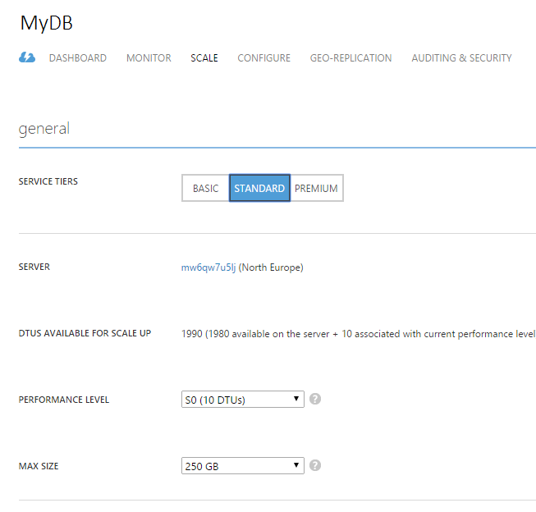
Upgrading/Downgrading Service Tier
T-SQL:
ALTER DATABASE Customers
MODIFY (edition='Standard')
PowerShell:
Set-AzureSqlDatabase $ctx $db -MaxSizeGB 50 -ServiceObjective $serviceObjective -Force
Can scale 4x during in 24 hours
Scale-down – fast
Scale-up - slow
Notes:
You can change service tier and performance level (service objective) using T-SQL, Powershell, REST or from portal.
-To downgrade a database, the database should be smaller than the maximum allowed size of the target service tier. For more information on the allowed sized for each service tier, see the service tier and database size table later in this section.
- When downgrading from a Premium service tier, you must first terminate all Geo-Replication relationships. You can follow the steps described in the Terminate a Continuous Copy Relationship topic to stop the replication process between the primary and the active secondary databases. - The restore service offerings are different for the various service tiers. If you are downgrading you may lose the ability to restore to a point in time, or have a lower backup retention period. For more information, see Azure SQL Database Backup and Restore. -You can make up to four individual database changes (service tier or performance levels) within a 24 hour period. -You can make up to four individual database changes (service tier or performance levels) within a 24 hour period.
http://msdn.microsoft.com/library/azure/dn369872.aspx
http://msdn.microsoft.com/en-us/library/azure/dn505719.aspx

Slide 29
Scaling Considerations
Database is online during scale operation
Scaling Up Latency – heuristic:
3 X (5min + DB size / 150 MB /min)
Empty DB - 15min, 150GB DB – 2 days
Scaling Down Latency -seconds
Notes:
https://msdn.microsoft.com/library/azure/dn369872.aspx
A SLO change for a database often involves data movement and therefore many hours may elapse before the change request completes and the associated billing change becomes effective. Data movement occurs for changes when upgrading downgrading a database and may also occur when changing performance level of the database
Generally, there is no data movement if the database performance level is changed from a higher performance level to a smaller size. In such cases, the latency of the SLO change is much faster and typically completes in the order of seconds.
You can change service tier and performance level (service objective) using T-SQL, Powershell, REST or from portal.
-To downgrade a database, the database should be smaller than the maximum allowed size of the target service tier. For more information on the allowed sized for each service tier, see the service tier and database size table later in this section.
- When downgrading from a Premium service tier, you must first terminate all Geo-Replication relationships. You can follow the steps described in the Terminate a Continuous Copy Relationship topic to stop the replication process between the primary and the active secondary databases. - The restore service offerings are different for the various service tiers. If you are downgrading you may lose the ability to restore to a point in time, or have a lower backup retention period. For more information, see Azure SQL Database Backup and Restore. -You can make up to four individual database changes (service tier or performance levels) within a 24 hour period. -You can make up to four individual database changes (service tier or performance levels) within a 24 hour period.

Slide 30
SQL Database
Service Tiers
Notes:
Run powershell script –show scaling via powershell script

Slide 31
Scaling Out
Notes:
30

Slide 32
Elastic Scale Client Tools (GA May 2015)
Set of .Net Libraries to enable Sharding of the data tier.
Has 4 main components:
Shard Map Management
Data Dependent Routing
Multi-Shard Queries
Split-Merge Management
DB1
Shard Map
DB2
Notes:
Let’s get into more details about Elastic Scale.
First of all, with Elastic Scaling in mind all databases are called Shards. Event a single database. Elastic Scale enables horizontal scaling - a design pattern in which databases (or shards) are added or removed from a shard set to grow or shrink capacity.
The public preview release for Azure SQL Database Elastic Scale makes developing sharded Azure SQL DB applications easier through 4 main features:
Shard Map Management: is the ability to register shards, describe mappings of individual sharding keys or key ranges to shards, and maintain this metadata as the layout of shards in the data tier evolves to reflect capacity changes.
Data Dependent Routing: provides the ability to open connections with a single easy call into the shard map of the application. Based on the sharding key value of the request, the application needs to determine the correct shard that holds the data for this sharding key value, and then open a connection to this shard to process the request.
Multi-Shard Queries (MSQ): Multi-shard querying works when a request involves several (or all) shards. A multi-shard query executes the same T-SQL code on all shards or a set of shards. The results from the participating shards are merged into an overall result set using UNION ALL semantics.
Split-Merge service: is customer-hosted service experience for growing and shrinking the data tier capacity and managing hotspots for sharded applications in situations that also involve movement of data. It builds on an underlying capability for moving shardlets on demand between different shards and integrates with shard map management to maintain consistent mappings and accurate data dependent routing connections. (Out of scope of this presentation)
<TODO>: you can use elastic scale to provide both horizontal and vertical elasticity
References:
http://azure.microsoft.com/en-us/documentation/articles/sql-database-elastic-scale-introduction/
http://azure.microsoft.com/en-gb/documentation/articles/sql-database-elastic-scale-get-started/
General reference: http://azure.microsoft.com/en-gb/documentation/articles/sql-database-elastic-scale-elasticity/

Slide 33




Shard Map Manager
Metadata container of defined Maps and Shards
List Map
Key | Shard
1 | Server 1, DB A
2 | Server 1, DB A
3 | Server 1, DB A
4 | Server 1, DB A
DB A
DB B
Range Map
Key Range | Shard
100-500 | Server 2, DB C
500-1000 | Server 2, DB D
1000-1500 | Server 3, DB E
1500-2000 | Server 4, DB F
DB C
DB E
DB D
DB F
Notes:
In a sharded database environment, a shard map maintains information allowing an application to connect to the correct database based upon the value of the sharding key. Understanding how these maps are constructed is crucial to managing shards in the Elastic Scale preview.
Shard maps can be constructed using lists of individual sharding key values, or they can be constructed using ranges of sharding key values. In this figure there are couple of examples, the first is using a List Map which contains the Shard that contains data rows based on keys; while the lower piece assigns ranges of keys to different shards or databases.
In the Elastic Scale APIs, the Shard Map Manager is a collection of shard maps. The data managed by a ShardMapManager .Net object is kept in three places: Global Shard Map (GSM): When you create a ShardMapManager, you specify a database (or shard) to serve as the repository for all of its shard maps and mappings. Special tables and stored procedures are automatically created to manage the information. This is typically a small database and lightly accessed, but it should not be used for other needs of the application.
Also, Every database that you specify to be a shard within a shard map will be modified to contain several small tables and special stored procedures that contain and manage shard map information specific to that shard. This information is redundant to the information in the global shard map but it allows the application to validate cached shard map information without placing any load on the GSM; this is called the Local Shard Map (LSM)
In addition to that, Each application instance accessing a ShardMapManager object maintains a local in-memory cache of its mappings. It stores routing information that has recently been retrieved. This serves as an Application Level Cache.
It is worthwhile to note here that Methods used for populating or changing the ShardMapManager data do not alter the user data stored in the shards themselves. For example, there are methods to Create Shard, Delete Shard and UpdateMapping. These will only affect the shard map metadata, they do not remove, add, or alter user data contained in the shards. Instead, these methods are designed to be used in conjunction with separate operations you perform to create or remove actual databases, or that move rows from one shard to another to rebalance a sharded environment.
References:
http://azure.microsoft.com/en-us/documentation/articles/sql-database-elastic-scale-shard-map-management/

Slide 34
Data Dependent Routing
Responsible for handing out connections to the correct database based on the shard map
Key Range | Shard
100-500 | Server 2, DB C
500-1000 | Server 2, DB D
1000-1500 | Server 3, DB E
1500-2000 | Server 4, DB F
Shard Map Manager
DB A
DB B
- DDR API
- Local Cache
DB C
DB D
Notes:
data-dependent routing provides ADO.NET applications the ability to easily direct database queries and commands to the appropriate physical database in a sharded environment. Each specific query or transaction in an application using data-dependent routing is restricted to accessing a single database per request. Using data-dependent routing, there is no need for the application to track the various connection strings or DB locations associated with different slices of data in the sharded environment. This is all taken care of implicitly by the underlying framework.
The method OpenConnectionForKey returns a database connection ready for issuing commands to the appropriate database based on the value of the key parameter. Shard information is cached in the application by the ShardMapManager, so these requests do not typically involve a database lookup against the Global Shard Map database.
If the validation against the local shard map fails (indicating that the cache is incorrect), the Shard Map Manager will query the global shard map to obtain the new correct value for the lookup, update the cache, and obtain and return the appropriate database connection.
References:
http://azure.microsoft.com/en-us/documentation/articles/sql-database-elastic-scale-data-dependent-routing/

Slide 35
Multi-Shard Querying
Provides Query Abstraction across multiple Shards
Multi-Shard Querying
DB A
DB C
DB B
DB D
Client Application
Union All
DB E
DB G
DB F
DB H
Notes:
Multi-shard querying is used for tasks such as data collection/reporting that require running a query that stretches across several shards.
<click>
This is in Contrast to Data Dependent Routing which performs all work on a single shard.
The Elastic Scale client library introduces a new namespace that provides the ability to query multiple shards using a single query and result. It provides a querying abstraction over a collection of shards. It also provides alternative execution policies, in particular partial results, to deal with failures when querying over many shards.
The main entry point into multi-shard querying is the MultiShardConnection class. Which behaves very similar to ADO.NET Sql connections. A key difference though is the construction of multi-shard connections. Where SqlConnection operates on a single database, the MultiShardConnection takes a collection of shards as its input. One can populate the collection of shards from a shard map for instance.
<click>
The query is then executed on the collection of shards using UNION ALL semantics to assemble a single overall result. Optionally, the name of the shard where the row originates from can be added to the output.
References:
http://azure.microsoft.com/en-us/documentation/articles/sql-database-elastic-scale-multishard-querying/

Slide 36
SQL Database
Elastic Scale

Slide 37
Elastic Database
Notes:
30

Slide 38
Elastic Database
Currently Preview
Elastic Database Pool
-manage DTU assignment to DBs automatically
Elastic Database Query
-ad hoc query across sharded DBs
Elastic Database Jobs
-batch processing of TSQL scripted jobs
Notes:
Elastics Database query:
Connect to a single SQL DB database using familiar SQL DB connection strings
Simple setup with T-SQL DDL
Transparent querying of many databases from a single database
Familiar programming experience with T-SQL, ADO. NET Linq, EF etc.
Elastic Database jobs:
Apply changes or administrative operations to many databases
Use familiar T-SQL scripts to define jobs
Built-in automatic retries in case of transient failures
Tightly integrated with elastic pools in the new Azure Portal
Designed for batch processing

Slide 39
PREVIEW
Elastic Database Model
Elastic databases, Elastic database pools
Pooled resources leveraged by many databases
Standard elastic pool provides 200-1200* eDTUs for up to 100* databases
Elastic Standard databases can burst up to 100 eDTUs (S3 level)
Create/configure pool via portal, PowerShell, REST APIs
Move databases in/out using portal, PowerShell, REST APIs, T-SQL
Databases remain online throughout
Monitoring and alerting is available on both pool and databases
Max per-database burst level
eDTUs
200
400
800
1200
*Additional pricing tiers may be introduced, and the ranges and limits may be increased during the preview
Notes:
https://azure.microsoft.com/en-us/documentation/articles/sql-database-elastic-pool/
An elastic database pool is a collection of available resources shared by the elastic databases in the pool. You can add databases to the pool or remove them at any time. These elastic databases share the resources (expressed as elastic database throughput units, or eDTUs) and storage capacity of the pool, but each elastic database uses only the resources it needs when it needs them, leaving resources free for other elastic databases when they need them. Instead of over-provisioning individual databases and paying for resources that sit idle, you allocate and pay a predictable price for resources of the elastic pool in aggregate. This spreads the cost so you can achieve a competitive business model, and each elastic database gains performance adaptability.
Databases that are great candidates for elastic database pools are typically active less than 50% of the time

Slide 40
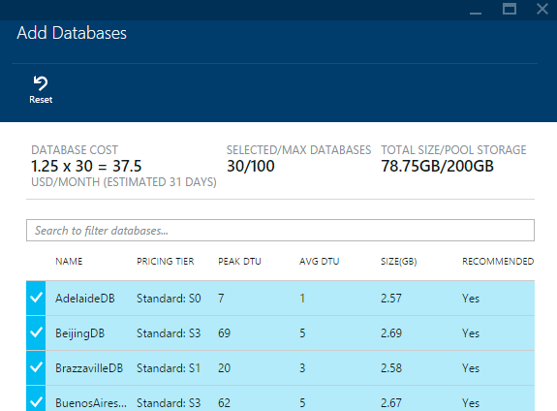
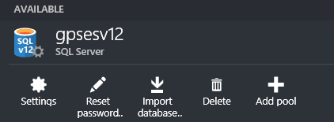
Elastic Database Pool Configuration
Pool is configured at server level
Standard pricing tier database only in Preview
Machine learning for pool recommendations

Slide 41
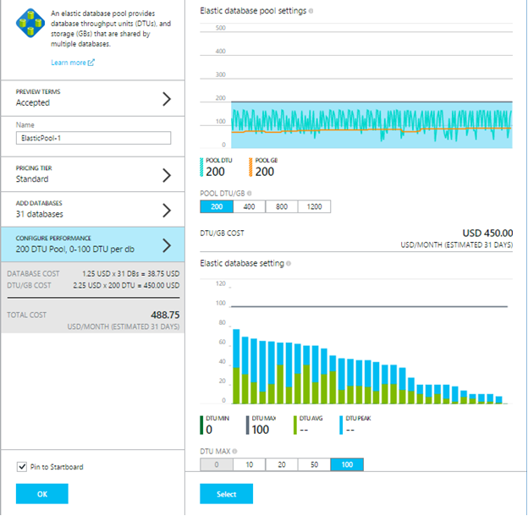
Pool Management
Modify DTUs assigned to pool
Set min/max DTU per database
Add remove databases from pool
removed DBs will be at S3 level

Slide 42
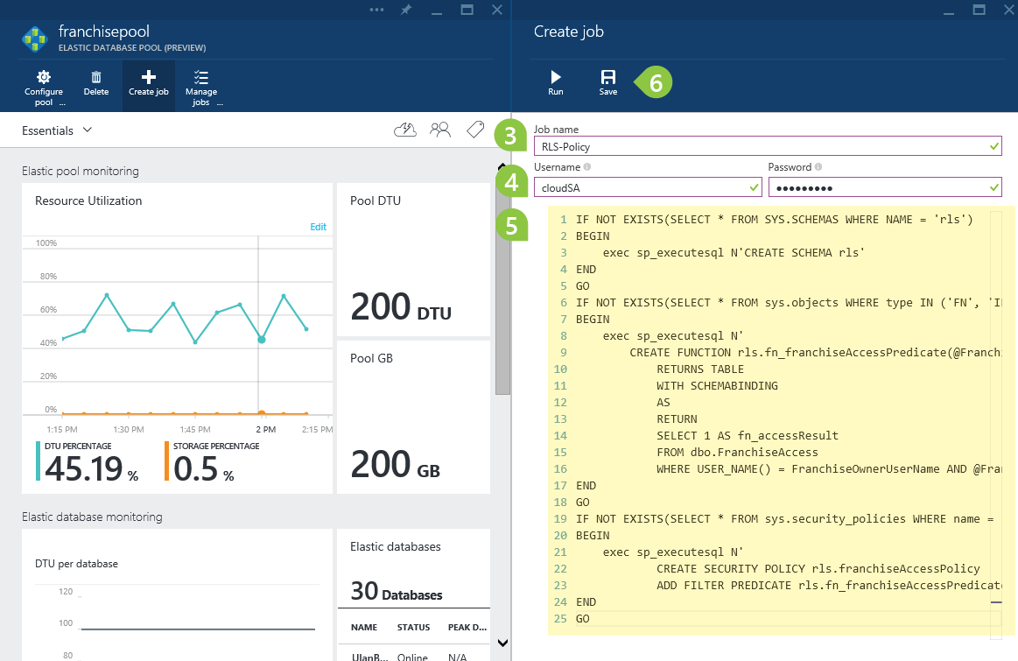
Elastic Database Jobs
Requires Service Setup
-Cloud Service, SQL Azure Database, Service Bus, Storage Account
Use T-SQL scripts to define jobs
Built-in automatic retries in case of transient failures
Integrated with elastic pools in the new Azure Portal
Notes:
https://azure.microsoft.com/en-us/documentation/articles/sql-database-elastic-jobs-service-installation/
https://azure.microsoft.com/en-us/documentation/articles/sql-database-elastic-jobs-create-and-manage/
The elastic database pool (preview) provides a predictable model for deploying large numbers of databases. Once you have created an elastic database pool, you can use elastic database jobs to execute administrative tasks across each database in the elastic database pool. For example, you can deploy new schema such as setting an RLS policy on each database to restrict data only to the person with the right credentials to view sensitive data

Slide 43
SQL Database
Business Continuity
Notes:
15
From a database perspective, there are four major potential disruption scenarios:
Local hardware or software failures affecting the database node such as a disk-drive failure.
Data corruption or deletion – typically caused by an application bug or human error. Such failures are intrinsically application-specific and cannot as a rule be detected or mitigated automatically by the infrastructure.
Datacenter outage, possibly caused by a natural disaster. This scenario requires some level of geo-redundancy with application failover to an alternate datacenter.
Upgrade or maintenance errors – unanticipated issues that occur during planned upgrades or maintenance to an application or database may require rapid rollback to a prior database state.
Business continuity is the ability to continue business operations when a crisis or disaster occurs. Business continuity planning requires processes, procedures, and measures to ensure that business operations can continue without interruption. This topic focuses on the Azure SQL Database features that enable business continuity and disaster recovery.
By storing your data in Azure SQL Database, you take advantage of many fault tolerance and secure infrastructure capabilities that you would otherwise have to design, acquire, implement, and manage. Let’s dig into several ways which either you get out of the box or could configure manually.
References:
[blog] http://azure.microsoft.com/blog/2014/07/12/spotlight-on-sql-database-active-geo-replication/
http://msdn.microsoft.com/en-us/library/azure/hh852669.aspx

Slide 44

Built-in Replicas and Failover
Logical
Database
Replica 1
Replica 2
Replica 3
Notes:
Azure SQL Database has a built-in high availability subsystem that protects your database from failures of individual servers and devices in a datacenter. Azure SQL Database maintains multiple copies of all data in different physical nodes located across fully independent physical sub-systems to mitigate outages due to failures of individual server components, such as hard drives, network interface adapters, or even entire servers. At any one time, three database replicas are running—one primary replica and two or more secondary replicas. Data is written to the primary and one secondary replica using a quorum based commit scheme before the transaction is considered committed. If the hardware fails on the primary replica, Azure SQL Database detects the failure and fails over to the secondary replica. In case of a physical loss of a replica, a new replica is automatically created. So there are always at minimum two physical, transactionally consistent copies of your data in the datacenter.
References:
http://social.technet.microsoft.com/wiki/contents/articles/1541.windows-azure-sql-database-connection-management.aspx
http://social.technet.microsoft.com/wiki/contents/articles/1695.inside-microsoft-azure-sql-database.aspx

Slide 45
Restore Deleted Database
Recovery after accidental database deletion
Backups retained for 7/14/35 days
Restores the database to the point of deletion (earlier backups are deleted)
Creates a new database on the server used by the original database
You can choose to failover to the restored database or use scripts to recover data
-7 days
Now
Self-service restore to point of deletion
x
DB1
DB1’
DB1
Notes:
You can also restore a database that is deleted accidently.
<click>
Through the portal, there is a section for deleted databases, which lists database that have been recently deleted.
<click>
Databases are kept for durations that mimics the backup durations. So, if you deleted a Basic Tier database, it remains there for 7 days, Standard stays 14 days and Premium stays for 35 days.
<click>
When you restore a deleted database, you will create a new database on the same original server.
References:
This slide comes from:
https://microsoft.sharepoint.com/teams/MVA/Content/Azure%20SQL%20Database%20New%20Serivce%20Tiers/_layouts/15/start.aspx#/SitePages/Home.aspx#InplviewHashce5c8d6a-1271-42bb-822e-3b345225afa5=Paged%3DTRUE-p_SortBehavior%3D0-p_Module%3D2%252e00000000000000-p_Content_x0020_Type%3DSlide%2520Presentation-p_ID%3D8-PageFirstRow%3D16
http://msdn.microsoft.com/en-us/library/azure/dn715779.aspx

Slide 46
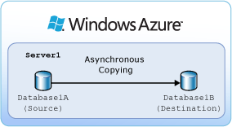
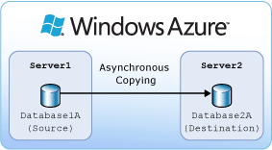
DB Copy
Scenarios
Application development and testing
Application upgrade
Application migration
Same Server Copying
Retains security principal
Cross Server Copying
Copies security principal
Notes:
The database copy operation copies a Microsoft Azure SQL Database to a new database. The copy can be created on the same or a different logical server. When the copying process completes, the new database is a fully functioning database that is independent of the source database. The new database is transactionally consistent with the source database at the time when the copy completes. The service tier, max size, and performance level of the database copy are the same as the source database.
When using the database copy feature, databases are copied asynchronously, so a connection to the Azure SQL Database server is not needed for the full duration of the process. You can copy a database by logging into the master database of the destination server and executing the Transact-SQL CREATE DATABASE statement with the AS COPY OF clause. Then, you can monitor the copy process by using the sys.dm_database_copies and sys.databases views on the destination server.
You can copy a database to the same Azure SQL Database server using a different database name or you can copy the database to a different Azure SQL Database server.
Same Server
the security principal you use to copy the database becomes the database owner (DBO) on the new database when it is created.
Cross Server
References:
http://msdn.microsoft.com/en-us/library/azure/hh852669.aspx
http://msdn.microsoft.com/en-us/library/azure/ff951624.aspx

Slide 47
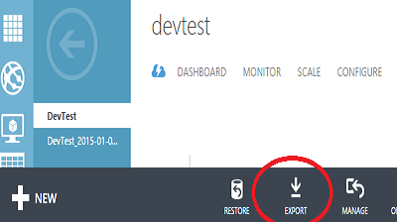
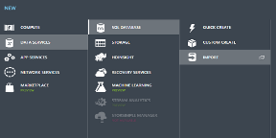
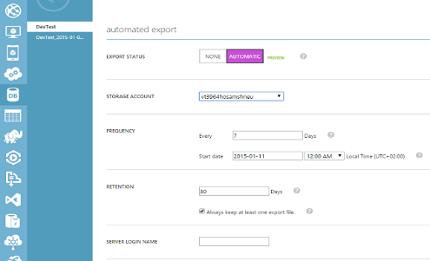
Import/Export
Manual Export
Export BACPAC file from the taskbar in Management Portal
Manual Import
Create a new DB by Importing a BACPAC
Automatic
Automated Export
Export on Schedule. Specify Interval and Retention
Notes:
The Import and Export service is the preferred solution for migration and archival scenarios
Import operations complete faster when using the S2 and higher performance levels. You can easily downgrade the performance level after the import operation completes. The database size, schema complexity, and performance level impact the duration of export operations. Consider temporarily increasing the performance level to decrease export times.
References:
http://msdn.microsoft.com/en-us/library/azure/hh852669.aspx
http://msdn.microsoft.com/en-us/library/azure/hh335292.aspx

Slide 48

Point-in-Time Restore
Recovery after accidental data corruption or deletion
Backups retained for 7/14/35 days
Backups are automatic, including transaction log every 5 mins are stored in Azure storage in the same region
Backups are retained while database exists and is being billed:
Basic, up to 7 days
Standard, up to 14 days
Premium, up to 35 days
Self-service restore to any point in time within the retention period
Always creates a new database on the same server
-7 days
Now
Self-service restore to any point in time
x
DB1
DB1’
Notes:
The Azure SQL Database service protects all databases in Basic, Standard and Premium Service Tiers with an automated backup system. Full backups are taken every week, differential backups every day.
Backup files are stored locally in the same data center as your databases with local redundancy. When you restore a database, the required backup files are retrieved and applied. The latest weekly and daily backups are also copied to the paired region in the same geo-political area for disaster recovery purpose.
These backups are retained for 7 days for Basic, 14 days for Standard and 35 days for Premium. Point-in-time restore is a self-service capability, allowing customers to restore a Basic, Standard or Premium database from these backups to any point within the retention period. Point-in-time restore always creates a new database.
The database backups are taken automatically with no need to opt-in and no additional charges. You only incur additional cost if you use the restore capability. The new database created by restore is charged at normal database rates.
Together, the automated backup system and point-in-time restore provide a zero-cost, zero-admin way to protect databases from accidental corruption or deletion, whatever the cause.
References:
This slide comes from:
https://microsoft.sharepoint.com/teams/MVA/Content/Azure%20SQL%20Database%20New%20Serivce%20Tiers/_layouts/15/start.aspx#/SitePages/Home.aspx#InplviewHashce5c8d6a-1271-42bb-822e-3b345225afa5=Paged%3DTRUE-p_SortBehavior%3D0-p_Module%3D2%252e00000000000000-p_Content_x0020_Type%3DSlide%2520Presentation-p_ID%3D8-PageFirstRow%3D16
[blog] http://azure.microsoft.com/blog/2014/10/01/azure-sql-database-point-in-time-restore/

Slide 49

Geo-Restore
Restore to a new region in case of datacenter outage
Geo-redundant copy of latest daily backup
Azure Storage
Basic, Standard and Premium databases
Geo-redundant copy of latest daily backup is kept in Azure Storage
Can restore from this backup to any region at any time.
May have up to 24 hours data loss.
-7 days
Now
Restore to different region
DB1
DB1
Notes:
Geo-restore is similar to point-in-time restore. You also get it automatically with basic, standard, and premium databases. Geo-restore, however, is designed to be a basic recovery option when a database is unavailable because of a large scale incident or outage in the region where your database is hosted. The feature uses Azure read-access geo-redundant blob storage to store the most recent daily backup of your databases in a different geographical location. Consider geo-restore as a basic disaster recovery solution if your application can tolerate up to 24 hours downtime and data loss.
References:
This slide comes from:
https://microsoft.sharepoint.com/teams/MVA/Content/Azure%20SQL%20Database%20New%20Serivce%20Tiers/_layouts/15/start.aspx#/SitePages/Home.aspx#InplviewHashce5c8d6a-1271-42bb-822e-3b345225afa5=Paged%3DTRUE-p_SortBehavior%3D0-p_Module%3D2%252e00000000000000-p_Content_x0020_Type%3DSlide%2520Presentation-p_ID%3D8-PageFirstRow%3D16
[blog] http://azure.microsoft.com/blog/2014/09/13/azure-sql-database-geo-restore/

Slide 50
Standard Geo-Replication
Geo-replicated secondary speeds up recovery and reduces data loss
Opt-in for Standard & Premium databases
Creates single offline secondary in a system-paired Azure region
Asynchronous data replication minimizes impact on primary
Self-service failover to secondary is enabled after Microsoft-declares the primary region is degraded
Replica has 75% cost of the primary
Geo-replicated offline secondary in paired region
DB1
DB1
Notes:
While geo-restore is available with all service tiers, it is the most basic of the DR solutions available in SQL Database with the longest recovery time.
For larger Standard or Premium databases, if significantly shorter recovery times are desired, or to reduce the likelihood of data loss you should consider using standard or active geo-replication. Both geo-replication recovery options offer a much lower recover times as they only require you initiate a failover to a continuously replicated secondary.
Standard geo-replication is available for standard and premium databases. It’s designed for less write-intensive applications that nevertheless process high volumes of data and have more aggressive recovery requirements than geo-restore can offer. When the primary database fails, it shows as degraded, and you can initiate failover to a non-readable secondary database stored in a different datacenter on another region.
<click>
When you use Standard geo-replication, One secondary database is created in a Microsoft defined “DR paired” Azure region. Standard Geo-Replication asynchronously replicates committed transactions from the primary database to one secondary database. The secondary, unlike Active Geo-Replication, is offline and does not accept client connections. It is visible on the list of secondaries and the continuous copy status can be monitored using the DMVs. The offline secondary can be switched to active if there is a datacenter issue resulting in unavailability of the primary database. In such an event, the failover property of the database is enabled. This allows you to terminate the relationship between the primary and the secondary, thus activating the offline database and making it an independent database ready to accept client connections.
References:
This slide comes from:
https://microsoft.sharepoint.com/teams/MVA/Content/Azure%20SQL%20Database%20New%20Serivce%20Tiers/_layouts/15/start.aspx#/SitePages/Home.aspx#InplviewHashce5c8d6a-1271-42bb-822e-3b345225afa5=Paged%3DTRUE-p_SortBehavior%3D0-p_Module%3D2%252e00000000000000-p_Content_x0020_Type%3DSlide%2520Presentation-p_ID%3D8-PageFirstRow%3D16
[blog] http://azure.microsoft.com/blog/2014/09/03/azure-sql-database-standard-geo-replication/

Slide 51
Active Geo-Replication
Fastest geo-recovery solution with option to use secondaries for load balancing
Self-service configuration and failover in Premium
Create up to 4 readable secondaries in any Azure region
Can be combined with an offline secondary
Automatic, asynchronous data replication
You choose which readable secondary to failover to and when
Replica has full cost
DB1
DB1
DB1
DB1
DB1
Geo-replicated readable secondaries in any region
Notes:
Active Geo-Replication is only available for premium databases. It’s designed for write-intensive applications with the most aggressive recovery requirements.
Using active geo-replication, you can create up to four readable secondaries on servers in different regions. These secondaries are maintained as continuous copies of the primary,
<click>
and you can initiate failover to a secondary in the same way as standard geo-replication.
Active geo-replication provides the highest degree of resiliency to temporary connection problems and high latency, so can support online application upgrade or relocation scenarios, as well as load balancing for read-only workloads.
References:
This slide comes from:
https://microsoft.sharepoint.com/teams/MVA/Content/Azure%20SQL%20Database%20New%20Serivce%20Tiers/_layouts/15/start.aspx#/SitePages/Home.aspx#InplviewHashce5c8d6a-1271-42bb-822e-3b345225afa5=Paged%3DTRUE-p_SortBehavior%3D0-p_Module%3D2%252e00000000000000-p_Content_x0020_Type%3DSlide%2520Presentation-p_ID%3D8-PageFirstRow%3D16
[blog] http://azure.microsoft.com/blog/2014/07/12/spotlight-on-sql-database-active-geo-replication/

Slide 52
Recovery Objectives (v12)
Basic
Standard
Premium
Uptime SLA | 99.99%
Predictable Performance | B | S0, S1 or S2 | P1, P2 or P3
 | Transactions per hour | Transactions per minute | Transactions per second
Database size limit | 2GB | 250GB | 500GB
Point In Time Restore (“oops” recovery) | Any point <7 days | Any point <14 days | Any point <35 days
Geo-Restore (restore last daily backup to another region) | ERT <12h, RPO<1h | ERT<12h, RPO<1h | ERT<12h, RPO<1h
Standard geo-replication (offline secondary, fixed DR pairing) | Not included | ERT<30sec RPO<5 sec | ERT>30sec RPO<5sec
Active geo-replication (up to 4 online readable secondaries, configurable regions) | Not included | Not included | ERT<30sec, RPO<5sec
* Target only, actual time depends on the data size and scale of restores
Notes:
business continuity when recovery is needed
V12 offers significantly improved recovery point objectives (RPOs) and estimated recovery times (ERTs):
https://azure.microsoft.com/en-gb/documentation/articles/sql-database-v12-whats-new/
References:
This slide comes from:
https://microsoft.sharepoint.com/teams/MVA/Content/Azure%20SQL%20Database%20New%20Serivce%20Tiers/_layouts/15/start.aspx#/SitePages/Home.aspx#InplviewHashce5c8d6a-1271-42bb-822e-3b345225afa5=Paged%3DTRUE-p_SortBehavior%3D0-p_Module%3D2%252e00000000000000-p_Content_x0020_Type%3DSlide%2520Presentation-p_ID%3D8-PageFirstRow%3D16

Slide 53
Monitoring
Notes:
5

Slide 54
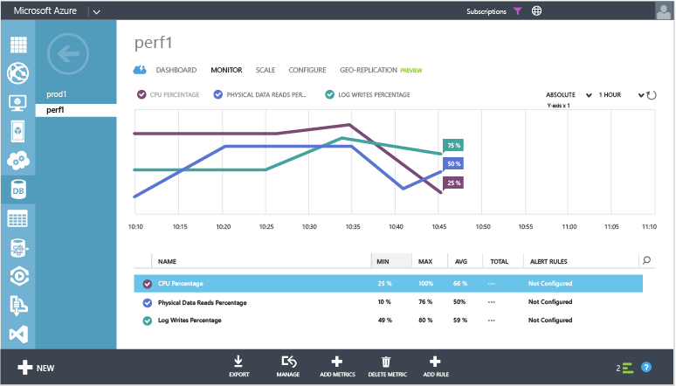
SQL Database Monitoring
Metrics to monitor performance:
CPU Percentage
DATA IO Percentage
DTU Percentage
Notes:
Once you’ve added these metrics, you can select them on the monitoring page to have them plotted over time. All three metrics show the average utilization percentage relative to the DTU of your database.
You can configure alerts on the performance metrics. Select the metric on the monitoring page, and then at the bottom of the page click Add Rule. Follow the wizard to configure your alert. You have the option to alert if the metrics exceeds a certain threshold or if the metric falls below a certain threshold.
For example, if you expect the workload on your database to grow, you can chose to configure an email alert whenever your database reaches 80% on any of the performance metrics. You can use this as an early warning to figure out when you might have to switch to the next higher performance level.
The performance metrics can also help you determine if you are able to downgrade to a lower performance level. Assume you are using a Standard S2 database and all performance metrics show that the database on average does not use more than 10% at any given time. It is likely that the database will work well in Standard S1. However, be aware of workloads that spike or fluctuate before making the decision to move to a lower performance level.

Slide 55
Security and Audit
In Preview (June 2015)
Notes:
5

Slide 56
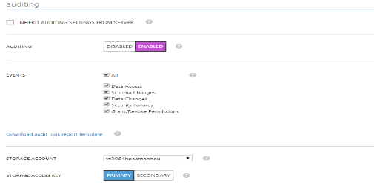
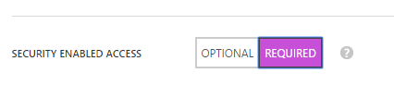
Auditing
Enable Auditing to track database events. Save them to Storage Account.
Make Security enabled access “Required” to force auditing for all connections
Downlevel clients connect using <server name>.database.secure.windows.net
Notes:
Azure SQL Database Auditing tracks database events and writes audited events to an audit log in your Azure Storage account. Auditing is available in preview for Basic, Standard, and Premium service tiers.
Auditing can help you maintain regulatory compliance, understand database activity, and gain insight into discrepancies and anomalies that could indicate business concerns or suspected security violations.
Any client which implements TDS 7.4 should also support redirection. For "Downlevel clients", i.e. which support TDS version 7.3 and below - the server
FQDN in the connection string should be modified to include secure
partial list of "Downlevel clients" includes:
.NET 4.0 and below,
ODBC 10.0 and below.
JDBC 4.0 and below (while JDBC 4.0 does support TDS 7.4, the TDS redirection feature is not fully supported)
References:
http://azure.microsoft.com/en-gb/documentation/articles/sql-database-auditing-get-started/
https://azure.microsoft.com/en-us/documentation/articles/sql-database-auditing-and-dynamic-data-masking-downlevel-clients/

Slide 57
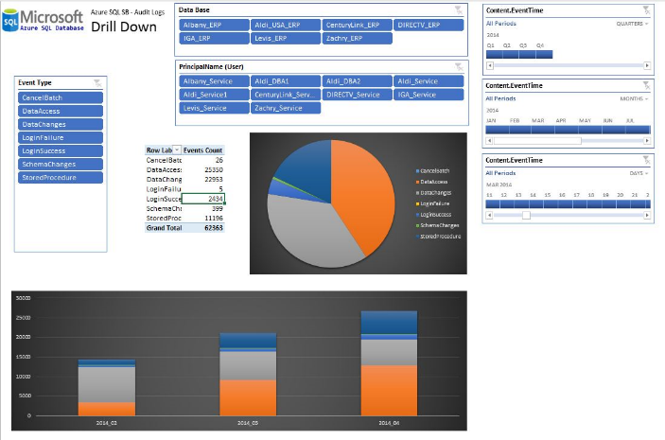
Viewing Audit data
Activities & Events
Access to data
Schema changes (DDL)
Data changes (DML)
Accounts, roles, and permissions (DCL)
Security exceptions
Access via Azure Storage and Excel & Power Query

Slide 58


Other Security Improvements in V12 preview
Data-Masking
At source or at client
Row Level Security
Transparent Data Encryption
Mask credit card number
XXXX-XXXX-XXXX-1234
Bank clerk sees data for his accounts only
Database, backups and logs are encrypted
Notes:
Row Level Secutiry is in PPREVIEW
A hospital can create a security policy that allows nurses to view data rows for their own patients only.
A bank can create a policy to restrict access to rows of financial data based on the employee's business division, or based on the employee's role within the company.
SQL Database TDE is based on SQL Server’s TDE technology which encrypts the storage of an entire database by using an industry standard AES-256 symmetric key called the database encryption key. SQL Database protects this database encryption key with a service managed certificate. All key management for database copying, Geo-Replication, and database restores anywhere in SQL Database is handled by the service – just enable it on your database

Slide 59
Data-Masking
Notes:
-Management Studio- open new connection using secure FQDN to the server connecting as dev – run query on server

Slide 60
Migrating to
Azure SQL Database
Notes:
10

Slide 61
Migration tools
Most commonly used tools:
SQL Database Migration Wizard (recommended)
Data-Tier Application (DAC)
Other useful tools
Generate and Publish Scripts
SQL Server Integration Services
SQL Server Import and Export
SQL Server Migration Assistant
bcp
SQL Server Data Tools
SQL Data Sync
Sync Framework
Notes:
NOTES:
Azure SQL Database Import and Export Service ( from the cloud )
Database Copy (on the cloud)
SQL Database Migration Wizard:
This is a shared source tool downloadable from codeplex (http://sqlazuremw.codeplex.com/). It can be used to migrate Schema and data. It can also be used to identify compatibility issues, fix them where possible, and notify you of the issues it finds.
Data-Tier Application (DAC)
A data-tier application (DAC) is a self-contained unit for developing, deploying, and managing data-tier objects. There are two options for migrating with DAC:
DAC BACPAC – This can be created by running the Export Data-tier Application which will export a BACPAC file, this file can be saved directly to Azure or imported later. This option can be used to export both data and schema but
DAC Package – Also created by Extract Data-tier Application instead of Saving to Azure, you can save it locally, make schema modifications and then deploy to Azure. This can be used
There are other tools which might be used in situations where you only want to migrate or synchronize data between on-premise SQL Server and Azure SQL Database or vise versa. Some of these would give you more flexibility or control over the data migration process such as the SQL Server Integration Services. Or maybe efficient export and import technique for large amounts of data such as bcp.
Generate and Publish Scripts Wizard
SQL Server Integration Services
SQL Server Import and Export Wizard
SQL Server Migration Assistant
bcp
SQL Server Data Tools
SQL Data Sync
Microsoft Sync Framework
Reference: http://msdn.microsoft.com/en-us/library/ee730904.aspx

Slide 62
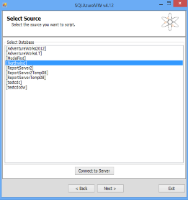
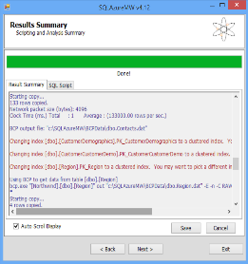
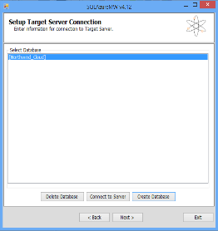
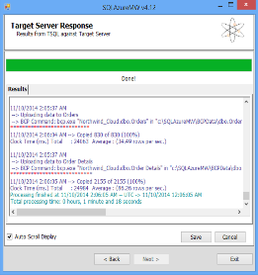
SQL Migration Wizard

Slide 63
Review
SQL in Azure, what are the options?
Scaling Azure SQL Database Service
SQL Database Business Continuity
Security and Audit
Migrating from on premise SQL to Azure SQL Database
Notes:
Source Control

Slide 64



Partner Services Contact Information
Phone Support
Email
Partner Portal
902 197 198
sppts@microsoft.com
http://aka.ms/mpnsupport

Slide 65
Activate your MSDN Benefits…
+
3 VMs for 16 hrs a day
80 VMs for 20 hour load test
Up to 100 web sites + DB
Up to
$150
33%^{off}
25%^{off}
89
per Month
Dev/Test VMs
Other Dev/Test
Countries

Slide 66
Thank you!
Gracias!
Merci!

